Slide 1
☺ TEAM-7 ☺
K.DURGA MANASWINI
P.SAI BHARGAVI
M.SWATHI
M.VINUTHNA
B.MADHAVI …

Slide 2
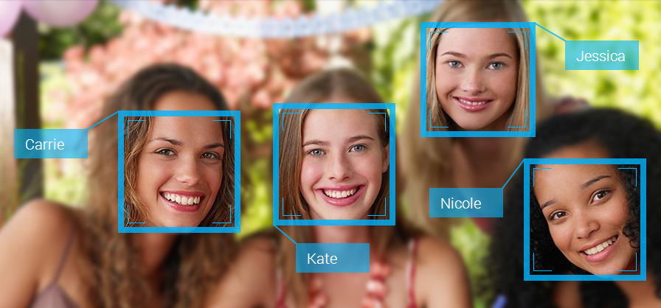
INTELLIGENT ALBUM CREATOR

Slide 3
INTRODUCTION
Generally after copying the images from camera or from some other devices sometimes we need to separate those photos accordingly.
The “Intelligent Album Creator” helps us in separating those pics in one folder.
We can keep all pics in one folder ,also we can separate and save the pics of different persons in different folders.

Slide 4
PROBLEM STATEMENT
Intelligent Album Creator is built for speed and ease for use.
The crucial step is to detect different faces .
This project works on gathering pictures into our library using “Face Detection technique” and “Convolutional Neural Networks” algorithm .

Slide 5
What is Face Detection !?
Face detection is a computer technology being used in a variety of applications that identifies human faces in digital images.
This technique is a specific use case of object detection technology that deals with detecting instances of semantic objects.

Slide 6
How it works!?
It often begins by searching for human eyes.
Once eyes are detected the algorithm then attempt to detect Facial regions.
This works by installing “OPENCV” to import ‘cv2’.
Haar cascade files like ‘Face_cascade’ , ’Eye_cascade’ are used to complete this algorithm.

Slide 7
Role of CNN

Slide 8
WORKING
‘Face Detection’ , ‘Convolutional Neural Networks ‘ and ‘Prediction ‘algorithms are to be applied to achieve our requirements.
To implement these algorithms ‘opencv’ which comes with a lot of pre-trained classifiers is to be installed inorder to import ‘cv2’.
Haar cascade files are used in Face Detection Algorithm to take the dataset.

Slide 9
.
Then Training and Testing of dataset is done by using CNN algorithm.
Prediction algorithm plays a role to predict the image and shows that the given image is from so and so folder..

Slide 10
APPLICATIONS
Google photos can be considered as the best Real-time application as it automatically separates the pictures of different persons into different folders.
Some other applications like Prime photos from Amazon and A+ gallery .

Slide 11
CONCLUSION
So with the help of this Intelligent Album Creator we can easily separate huge data sets containing thousands of images into different folders.

Slide 12
.
THANKYOU ! ☺

